Slide 1
Faculty Senate Meeting
February 25, 2021

Slide 2
Meeting procedure
The same rules apply over virtual meetings as over in-person meetings
Only Senators may debate motions
Only Senators can vote
If you are not a Senator, or a proxy, you cannot vote or debate
Do not speak over someone, or out of order
Raise your hand within the Zoom app
The President will call on you and then you will have the floor
Unless you have been recognized (been told you have the floor), you may not speak

Slide 3
Agenda
Call to Order and Roll Call
K.C. Dolan, Secretary

Slide 4
Agenda
Approval of Minutes
November 19, 2020 and
January 28, 2021

Slide 5
Agenda
III. Campus Reports
A. Staff Council
A. Kossuth

Slide 6
Staff Success Center
https://staffcouncil.mst.edu/staffsuccesscenter/
Spring Staff Appreciation

Slide 7
Agenda
III. Campus Reports
B. Student Council
L. Hierlmeier

Slide 8
Agenda
III. Campus Reports
C. Council of Graduate Students
J. Valentin-Sivico

Slide 9
Issue of concern: graduate students whose advisor departs from Missouri S&T
Policy recommendation for the endorsement of the Faculty Senate:
The Department Chair should strive to identify an alternate advisor and alternate source of funding for students whose advisor departs from Missouri S&T.

Slide 10
Issue of concern: graduate students whose advisor departs from Missouri S&T
Background: At least three student cases have been brought to the Council of Graduate Students' attention.
Assistance to identify alternate advisor/funding required the intervention of other university administrators advocating on behalf of the impacted students.

Slide 11
Agenda
IV. Guest Speaker
A. General Education Committee
J. Musser

Slide 12
General Education Oversight Committee Progress Report
February 25, 2021
Faculty poll results regarding ideal General Education
~ 1/2 content-based and 1/2 skill-based learning outcomes
~ 2/3 introductory courses and 1/3 upper-level courses
General Education Learning Outcomes (GELOs) created
Synthesis of S&T Undergraduate SLOs and CORE-42 SLOs
Detailed “sub-GELOs” mostly created
Work being done on policy and procedures
Gen-Ed course application and renewal
GELO assessments
Standing committee membership and role

Slide 13
General Education Oversight Committee Progress Report
February 25, 2021
Contribution to writing of HLC interim report (Due May 31, 2021)
Expected impact on S&T curriculum
Gen-Ed identified courses similar to current set
Opportunity to identify additional courses as Gen-Ed courses
Gen-Ed course instructors will be aware of and required to address the GELOs associated with their course.
Associated GELOs will be assessed for each Gen-Ed course
Assessments will be considered in Gen-Ed course renewal and will be used to identify deficiencies in the Gen-Ed program.

Slide 14
Agenda
V. President’s Report
S. Raper

Slide 15
President’s Report
Dr. Stephen Raper, Faculty Senate President

Slide 16
General Items
IFC – February 18: Informational, ELearning, other
Off site course delivery: Equipment and Financial
On-line teaching certification requirement extended to Fall 2022
Test Optional (ACT and SAT) extended to Fall 2022
Integrity of Title IX Office – Interim Provost Roberts to provide more detail

Slide 17
General Items continued
Proposed modification to current By-Laws
Planning for Live Commencement
Referrals to FS Standing Committees
Uncertainty, stress, morale, change

Slide 18
Agenda
VI. Administrative Reports
A. Chancellor’s Report M. Dehghani

Slide 20
Agenda
VI. Administrative Reports
B. Interim Provost’s Report S. Roberts

Slide 21
Freshman deposits are far ahead of last year, due to the Kummer Vanguard Scholarship and the exceptional effort of Enrollment Management and faculty.
Freshman Deposits
Kummer Vanguard deposit deadline
Weeks prior to 4th-week census

Slide 22
CET averages are available to chairs, deans, provost, and chancellor through IT per the recommendation from the Committee on Effective Teaching. CET averages are typically exceptional, with the most common averages falling between 3.01 and 4.
CET Averages by section from SP18 to FA20
# of Sections
0-1.00 1.01-2.00 2.01-3.00 3.01-4.00
Range of CET Averages

Slide 23
Faculty Online Teaching Certification
Required of all faculty teaching online per guidelines at https://keeplearning.umsystem.edu/instructors/workshops-seminars/online-teaching-certification-seminar
Current program emphasizes non-STEM disciplines and asynchronous delivery.
Fast-track option is available to those who have 3 or more years of online teaching experience. See https://keeplearning.umsystem.edu/instructors/workshops-seminars/online-teaching-recertification-seminar
Over 100 S&T faculty have already become certified through these programs or other programs that satisfy the certification program, and many others are registered to do so.
Because the certification program is subject to continuous improvement, especially to support STEM disciplines and synchronous delivery, the deadline for S&T’s faculty has been extended to the beginning of the Fall 2022 semester.

Slide 24
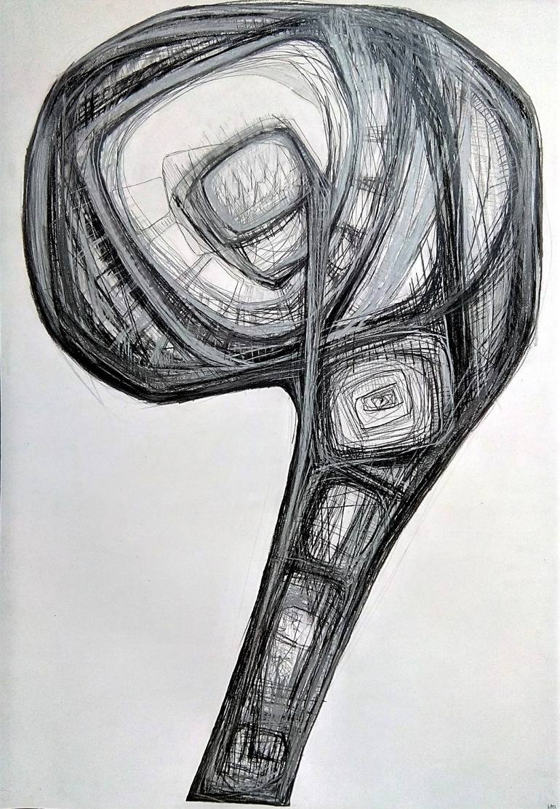
Questions?
Milica Vuković

Slide 25
Agenda
VII. Reports of Standing Committees
A. Curricula S. Raper

Slide 26
Campus Curricula Committee Report
25 February 2021
CCC Meetings -10 February
-2 March
Total Committee Activity
7 Course Change Requests (CC Forms)
14 Program Change Form (PC Forms)
2 Experimental Course Requests (EC Forms)

Slide 27
Campus Curricula Committee Report
25 February 2021
Course Changes (CC) Requested
File: 4770 GEOLOGY 5510 : Organic Geochemistry
File: 4767 HISTORY 3534 : History of Medieval and Early Modern Science
File: 4690 HISTORY 4580 : Issues in Science, Technology and Society
File: 961.7 IS&T 6641 : Advanced Digital Commerce and IoT Analytics
File: 2364.4 MET ENG 5480 : Refining Of Metals
File: 1630.1 NUC ENG 2406 : Reactor Operations I
File: 2295.1 NUC ENG 3205 : Fundamentals of Nuclear Engineering

Slide 28
Campus Curricula Committee Report
25 February 2021
Program Changes (PC) Requested
File: 268.13 GEO ENG-MS : GEOLOGICAL ENGINEERING MS
File: 166.22 GL&GPH-MS : Geology and Geophysics MS
File: 171.6 PE ENG-MS : Petroleum Engineering MS
File: 374 PROPOSED : English & Technical Communication BS
File: 192.40 PSYCH-BA : Psychology BA
File: 193.38 PSYCH-BS : Psychology BS
File: 293.2 ANA&DTA-CT : Bus Analytics & Data Sci CT
File: 295.2 CYBERMG-CT : Cyber Mgmt & Info Assurance CT
File: 351.3 GEINTEL-CT : Geoanalytics and Geointelligence Certificate
File: 347.5 GEOPHY-CT : Geophysics Graduate CT
File: 291.5 MGTLEAD-CT : Management and Leadership
File: 348.4 PET SYS-CT : Petroleum Systems CT
File: 376 PROPOSED : UCT - Medieval and Renaissance Studies
File: 375 PROPOSED : UCT - Science, Technology, and Society

Slide 29
Campus Curricula Committee Report
25 February 2021
Name Change Requested
Nuclear Engineering and Radiation Science

Slide 30
Campus Curricula Committee Report
25 February 2021
For Informational Purposes; No Senate Approval Required
Experimental Courses (EC) Requested
File: 4766 CIV ENG 5001.006 : Geotechnical In-Situ Soil Testing
File: 4768 COMP SCI 5001.013 : Theory of Reinforcement Learning

Slide 31
Campus Curricula Committee Report
25 February 2021
Curriculum committee moves for FS to approve the 7 CC and 14 PC form actions
Discussion: Questions or comments?

Slide 32
Agenda
VII. Reports of Standing Committees
B. Administrative Review W. Huebner

Slide 33
Administrative Review Committee
2020-2021 Members
Diana Ahmad
Wayne Huebner, Chair
Bih-Ru Lea
Kelly Liu

Slide 34
Administrative Review Committee
Positions approved for review
Chancellor (Dehghani)
Vice Chancellor Finance & Operations (Plain )
Deputy Provost for Academic Excellence (Brow)
Vice Provost and Dean Enrollment Management (Sivadasan)
Vice Provost Global Learning (Moore)

Slide 35
Administrative Review Committee
Approved timeline and process
Action | Time
Review list to faculty senate for approval | January 28th
Job descriptions | February 12th
Development of questionnaires | February
Questionnaires to FS for review/approval | February 25th
Statement of accomplishments due | February 26th
Review of administrations | March 15th – April 2nd
Results to FS officers | April 16th
Final report to FS | May 14th

Slide 36
Survey Questions
Survey questions were developed from the job descriptions provided by the administrator being reviewed.
For each of the survey questions the following scale will be used:
Strongly Agree, Agree, Disagree, Strongly Disagree, Insufficient Information/Unsure
For each administrator the last survey question is:
Administrator X should be retained in his/her position as Z.
Yes / No

Slide 37
Mo Dehghani, Chancellor
1. Provides strong leadership for the development of Missouri S&T
• Effectively provides leadership to all areas of the university
• Effectively encourages balance between the research, teaching and service missions of the university
• Effectively recruits and retains talented faculty, students, and staff
• Effectively promotes philanthropy to benefit all parts of the university
• Effectively develops relationships with government entities, including local, state, and federal
2. Provides strong leadership that
• Effectively enhances shared governance
• Effectively developed well thought out strategic goals
• Effectively enhances the development and success of all S&T students
• Effectively enhances the development and success of all S&T faculty
3. Provides support for all areas of the university
• Effectively seeks out opinions of campus members, including faculty, staff, and students
• Effectively develops relationships with diverse stakeholders and alumni for financial advantages, as well as the enhancement of the campus

Slide 38
Richard Brow, Interim Deputy Provost for Academic Excellence
1. Provides strong leadership for the development of bold strategies to achieve the important objectives of a public research university.
• Effectively communicates and interacts with faculty, chairs, and the deans about academic visions
• Works effectively to streamline and create new programs
• Effectively leads programs of excellence
• Coordinates effectively on faculty participation in developing strategies for professional and corporate education, digital delivery of coursework, undergraduate education and enrollment management, etc.
Provides effective leadership in developing and coordinating travel-related policies for the campus in response to the pandemic
3. Provides effective leadership in organizing faculty involvement in planning activities associated with the Kummer Institute
• Works effectively to establish faculty advisory committees on the KI research centers and the Kummer College of Innovation, Entrepreneurship and Economic Development and communicates effectively with faculty of these activities
• Communicate effectively with faculty on the policies for the Kummer Innovation and Entrepreneurship program

Slide 39
Cuba Plain, Interim Vice Chancellor Finance and Operations
1. Provides strong leadership to the financial management of Missouri S&T
• Effectively oversees all campus finance functions including budgeting and planning, capital budgeting, accounting, financial management and reporting, cash collections and management, and accounts receivable.
• Strategically manages finances to support the University's vision and academic missions
2. Effectively leads the administrative and support operations of the University, including the offices of:
• Facilities Services (including Facilities Operations, Design, Construction and Space Management, and Environmental Health and Safety)
• Information Technology (including Campus Technology and Support, Network and Computing Systems, Research Support, Information Security, Project Management, and IT Business Services)
• University Police (including Safety and Security, and Parking)
• Human Resources
• Fiscal Services (including Budget and Accounting, Fiscal Managers, and Cashier’s Office and Student Loan Collections)
• Printing and Mail
3. Is an Effective Communicator and Team Player
• Displays strong interpersonal and communication skills with a wide range of constituencies in academia, business and government

Slide 40
Shobi Sivadasan , Vice Provost of Enrollment Management
1. Provides strong leadership to the recruitment and retention of undergraduate and graduate students
• Effectively supervises the unit leaders in the offices of Undergraduate Admissions and Graduate and International Admissions
• Effectively administers New Student Programs, Enrollment Systems and Operations, Project Lead the Way, the Registrar, and Student Financial Assistance
• Evaluates and improves the practices of the student enrollment experience (i.e., admissions, financial aid, registration and orientation)
2. Collaborates with the college deans and department chairs to lead the development, implementation and ongoing evaluation of a comprehensive enrollment management strategic plan that addresses short-term and long-term undergraduate and graduate enrollment goals that includes student diversity and quality goals
• Interacts in a collegial manner with faculty, staff, students, and off-campus constituents
3. Is an Effective Communicator and Team Player
• Participates and leads S&T’s overall promotional efforts by workings closely with faculty, staff, and administration to enhance the university’s reputation in the U.S. and overseas
• Recommends strategic initiatives, actions, and policy considerations to the Chancellor, Provost, and the Leadership team
• Collaborates with the Office of Finance & Operations on the University budgetary projections

Slide 41
Caprice Moore, Interim Vice Provost for Global Learning
1. Provides effective leadership and support programs, services, and initiatives delivered by the Office of Global Learning, that includes
Ensures high quality online and distance learning services and programming in asynchronous and synchronous platforms
Achieves enrollment and revenue growth targets for online and distance academic programs
Builds internal and external partnerships with constituents, alumni, UM System administration, and eLearning team members
Ensures compliance and management of NC-SARA, HLC online assessment, and required online surveys for rankings and reporting needs
Oversees K-12 engagement and event management, including summer camp programming
2. Ensures opportunities for faculty to have input into decisions in programs, services, and initiatives delivered by the Office of Global Learning
Effectively communicates changes in important policies, procedures, and regulations and their likely outcomes in a timely manner in programs, services, and initiatives delivered by the Office of Global Learning
Establishes and maintains collaborative relationships with the following constituents:
College deans, Academic departments, Faculty, Alumni Office, Development Office, UM System eLearning

Slide 42
Agenda
VII. Reports of Standing Committees
C. Committee on Excellence in Teaching D. Oerther

Slide 43
Motion to expand access to CET scores
Whereas 6 CSR 10.9.010 Rules for Posting of Consumer Information states, “…where feasible, each institution shall post on its web site instructor ratings by students…”;
Whereas CRR 300.030 states, “…[the Committee for Effective Teaching] makes recommendations to the Faculty Senate, and the Provost, regarding the instruments used for student evaluation of teaching, the procedures for conducting these evaluations, and policies related to the public disclosure of the evaluation results (emphasis added)…”;
Whereas a thorough search has uncovered no written policies of the CET with regard to public disclosure of student evaluations of instructors;
Whereas the historical practice of the CET has been that student evaluations of instructors are viewed as confidential between the student and the instructor;
Whereas the historical practice of the CET has been that disclosure of student evaluations of instructors has been limited to the sole discretion of the instructor;
Whereas the historical practice of the institution has been that student evaluations of instructors are included for viewing by students as part of the enrollment process via Joess;

Slide 44
Whereas the historical practice of the institution has been that deidentified student evaluations of instructors are used in the awarding of accolades and recognition for high teaching performance;
Whereas the current institutional strategic plan adopted in 2018 states, “…department chairs of faculty with teaching scores below 2.0 for two consecutive semesters will encourage faculty members to engage in CAFE mentoring activities, department chair mentoring…”;
Whereas the other institutions of the University of Missouri System regularly provide to various administrators the results of student evaluations of instructors (i.e., to Department Chairs, Deans, and Provost, including via annual evaluations and instruments such as MyVita);
Whereas there has been, remains, and will continue to be a chronic need for arriving at fair judgments of a faculty member’s teaching (i.e., AAUP Statement on Teaching Evaluation);
Whereas the CET has been, remains, and will continue to be involved in a process of continuous improvement of the instruments used for student evaluation of teaching and the procedures for conducting these evaluations;

Slide 45
Now there, the Committee for Effective Teaching recommends
Numeric results of the current instrument used for student evaluation of teaching (i.e., both the State mandated questions as well as the campus questions) be made available to administrators (i.e., Department Chairs, Deans, and Provost, including via instruments such as MyVita);
This availability be limited to the results beginning with the Autumn 2020 semester and future results (i.e., disclosure of results for Summer 2020 and prior would remain at the sole discretion of the instructor);
Written comments would be excluded from this availability because these comments were collected from students with a promise of anonymity and an implication of sole disclosure to the instructor. In the view of the CET, sharing written comments collected using the current instrument would be serious breach of trust among student, instructor, and institution.
An improved instrument used for student evaluations be developed allowing students to offer both anonymous comments to the instructor plus anonymous comments to administrators.

Slide 46
Agenda
VII. Reports of Standing Committees
D. Budgetary Affairs
M. Fitch

Slide 47
Budgetary Affairs Committee
Feb 25, 2021
Referrals
None
Continuing referrals:
Report on the “big picture balance sheet”
Current and next FY budget

Slide 48
Big Picture Budget
Current FY budget remains on target
Remain hopeful to replace vacated positions (≠ layoffs)
Next FY planning just beginning
State funding projected as flat
Tuition revenue largest uncertainty both number of students and % tuition increase (1.3% mentioned)
Insurance cost increase likely
System wants compensation adjustment (merit, equity, or/and minimum wage)
COVID funding part 3 expected to not impact S&T

Slide 49
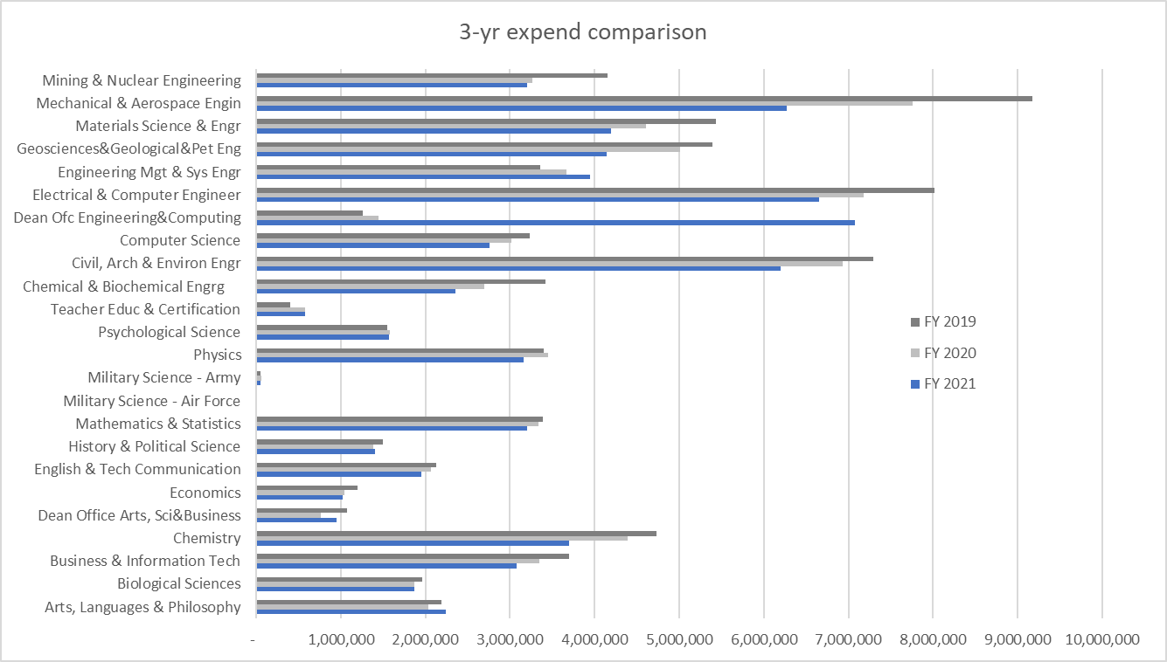
Expenditures ($)
$2.6 MM
Former administrators?
?
a) $1.9 MM Supplementary Core Instruction in Dean’s budget, will move to Dep’ts, previously Provost’s
b) $2 MM open faculty lines from Dep’ts
~20% decline

Slide 50
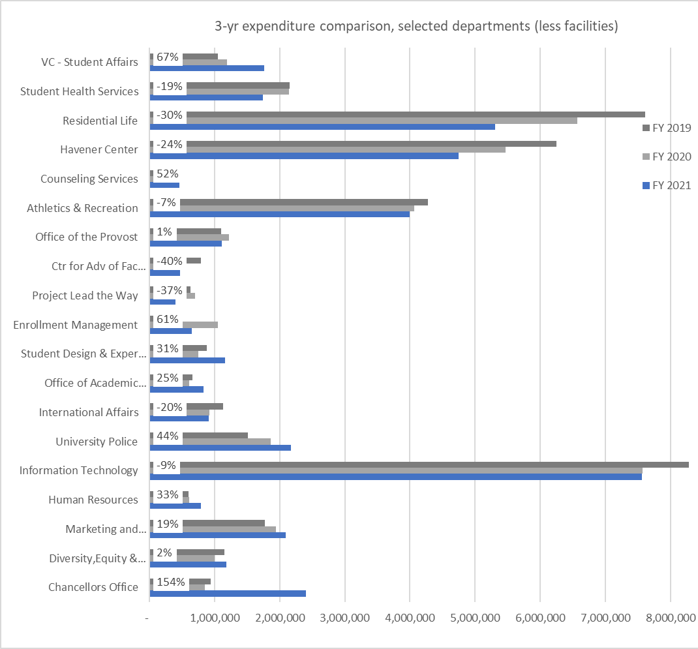
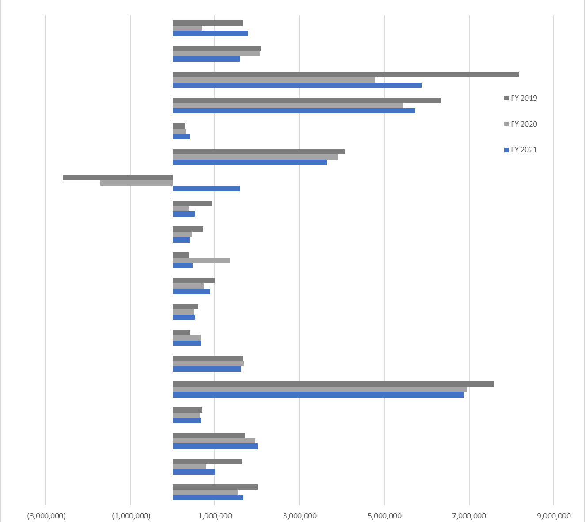
‘Income’
2020 $1.8 MM ‘loss’
2021 $1 MM ‘profit’
$0.74 MM loss over three yrs
Transfer out > revenue
2020 big cut
Provost had funds from Global (FY18) and IA (FY19), FY19:
$2 MM for classroom project, $2 MM for Schrenk, $600K Vivarium, $677K Supplementary Core Instruction, $350K admissions
FY20:
VSP $3 MM
2020 big deficit, 2021 big cut
?
2021 big GO spend
$1.5 MM req’d match for Tier 1 funds from System, for capital equipment
$400 K is higher compensation in DEI (but not any longer), marketing costs for sesquicentennial
Increased auxiliary spend
IT: $700K cut, continuing $600-700K annual deficit
2021 big spend (+1.5 MM endow, + 0.4 MM GO)

Slide 51
Agenda
VII. Reports of Standing Committees
E. Information Technology
J. Singler

Slide 52
Faculty senate referral to the ITCC:
Would the ITCC advise IT on the future of greenscreen production classrooms?
The ITCC formed an ad hoc committee:
Andreas Eckert, chair (vice chair ITCC, Geosciences and Geological and Petroleum Engineering)
Caprice Moore (Global Learning)
Jeff Jennings (CAFE)
Levi Hudson (IT)
David Wright (English and Technical Communication)
Maciej Zawodniok (Electrical and Computer Engineering)

Slide 53
Information items:
The ITCC received a brief summary of submissions to the new IT-concern email and the responses from IT
We discussed IT methods to communicate to S&T, and the new IT blog https://itcomms.mst.edu/
Discussions will continue
IT still having trouble retaining and hiring staff
IT may be short-handed – this may cause service delays
IT has trouble offering competitive salaries (budget cuts)
More changes coming…

Slide 54
IT Research and Leadership Update
Research leadership
Mark Bookout to reassume leadership of S&T RSS and assume MU Research IT team
Reduce or eliminate duplicative investments
Hire for needed talent v. duplicate talent
Invest in expertise and focus on retention

Slide 55
IT Leadership & Research Update
CIO
Permanent CIO to arrive ~ 7/1/21 or sooner
Interim CIO – Brandon Hough
Interim Associate CIO – Mark Bookout

Slide 56
Agenda
New Business

Slide 57
Agenda
IX. Adjourn
57

